Slide 1
INSTAGRAM USER ANALYTICS

Slide 2
PROJECT DESCRIPTION
In this project of Instagram User Analytics , we are going to find how users engage and interact with digital platforms like (Instagram) and this helps in deriving data for marketing, Business development and other teams working for the company.
APPROACH
PURPOSE
We are going to create a Database in MYSQL Workbench and use MYSQL queries to find out the required data from the data stored in the database.
We are going to find some insights such as “Oldest Users Who Have Not Posted A Single Photo Yet”, “Most Liked Photo”, “Trending Hashtags”, “Day When Most Users Register” With some matrices like “Users Engagement” and “Fake Bots”.
TECH-STACK USED
MYSQL Workbench 8.0 CE,
to run MySQL Queries.

Slide 3
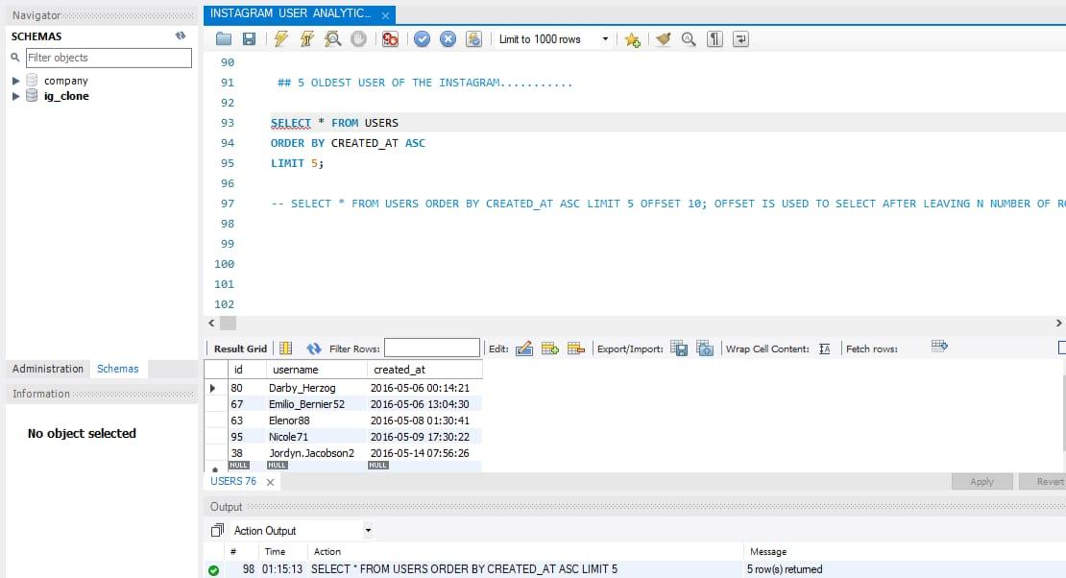
MYSQL QUERY & RESULT
INSIGHT
REWARDING MOST LOYAL USER
We have to find ‘top five users who have been using Instagram for the longest time’.
Result shows that these users Stick to Instagram and trust this app as they are the oldest users.

Slide 4
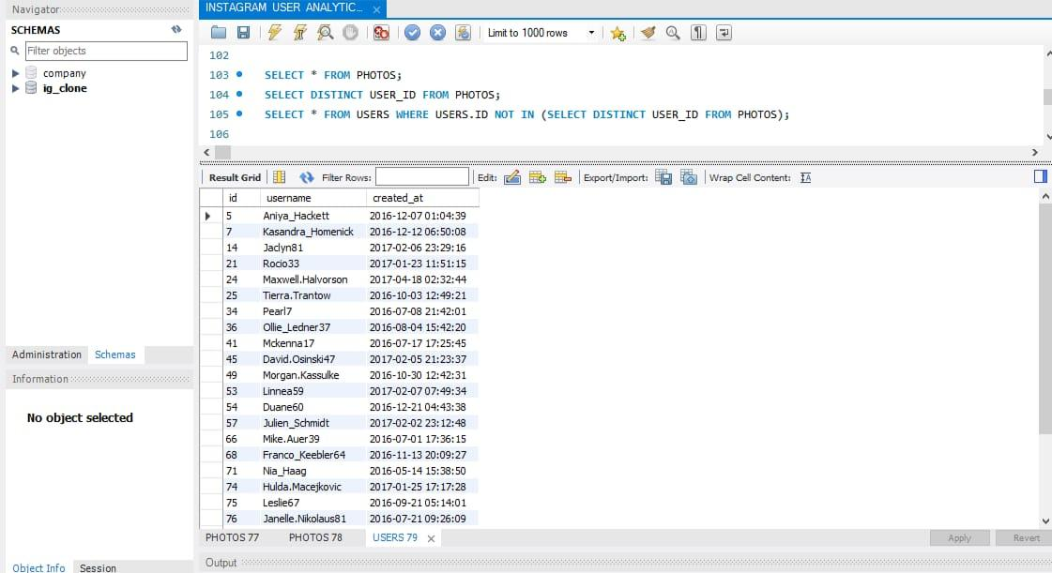
MYSQL QUERY & RESULT
INSIGHT
REMINDING INACTIVE USERS TO START POSTING
Here we will find ‘those users who have never posted a single photo’.
Result, These users might have no interest on social media platforms or they might not personally like this platform.

Slide 5
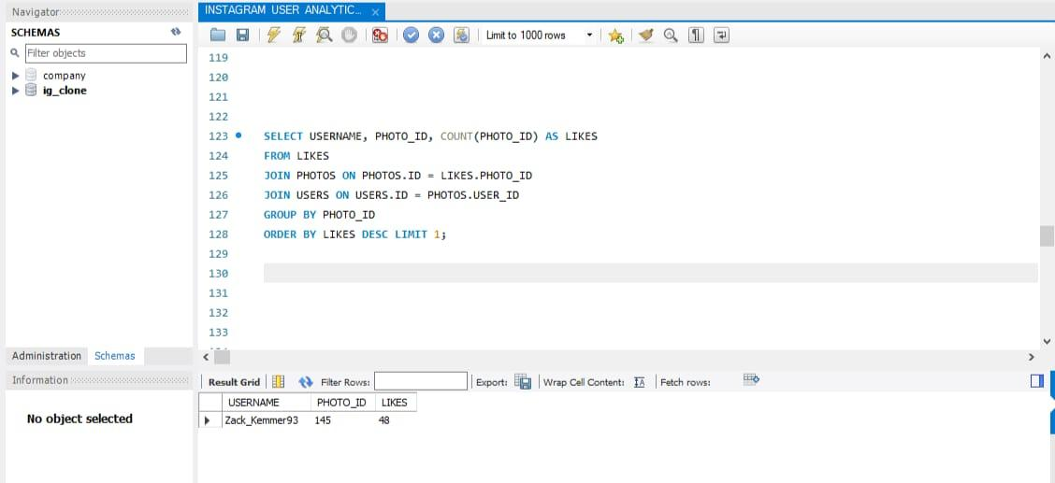
MYSQL QUERY & RESULT
INSIGHT
DECLARING CONTEST WINNER
We have to find ‘those users who got maximum number of likes On his single photo’ and we’ll declare him the contest winner.
Result, user who gets most no. of likes on his single photo is consider as famous personality.

Slide 6
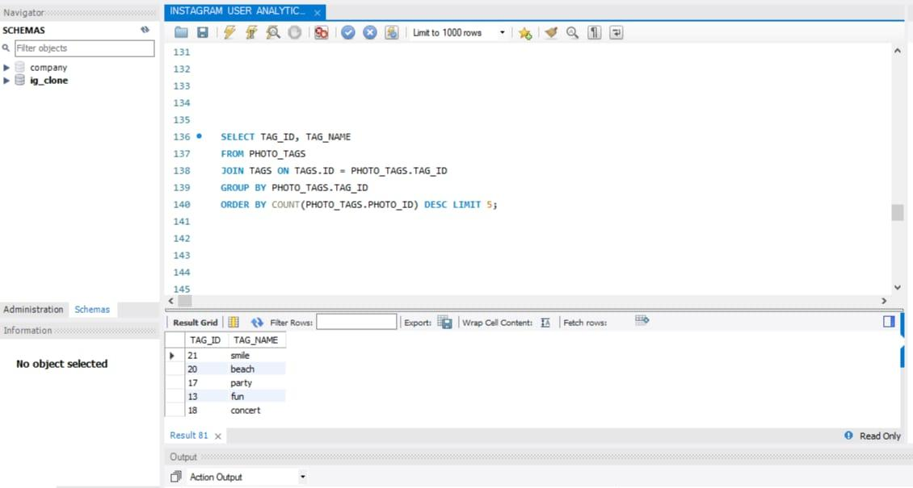
MYSQL QUERY & RESULT
INSIGHT
HASHTAG RESEARCHING
Here we will find ‘top five hashtags’ which are mostly used by the users.
Result, By using these hashtags we can reach out to maximum no. Of users.

Slide 7
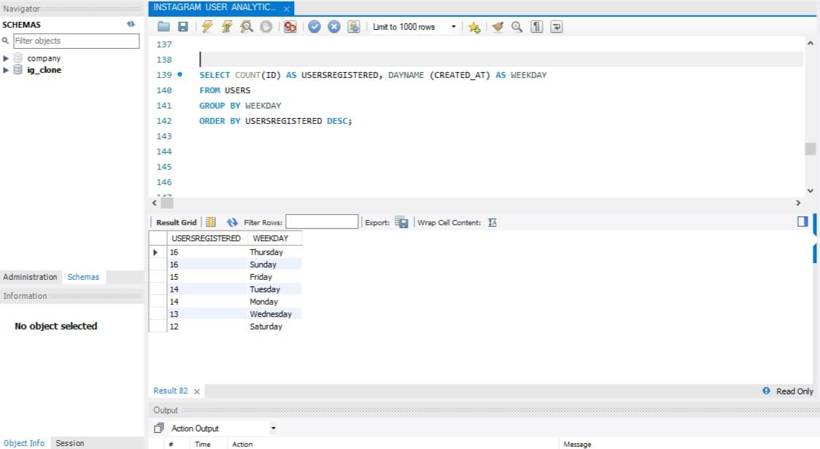
MYSQL QUERY & RESULT
INSIGHT
LAUNCH AD CAMPAIGN
We have to find ‘those days of a week which would we best to launch ad’.
Result when obtained we can connect or reach out to maximum number of users online.

Slide 8
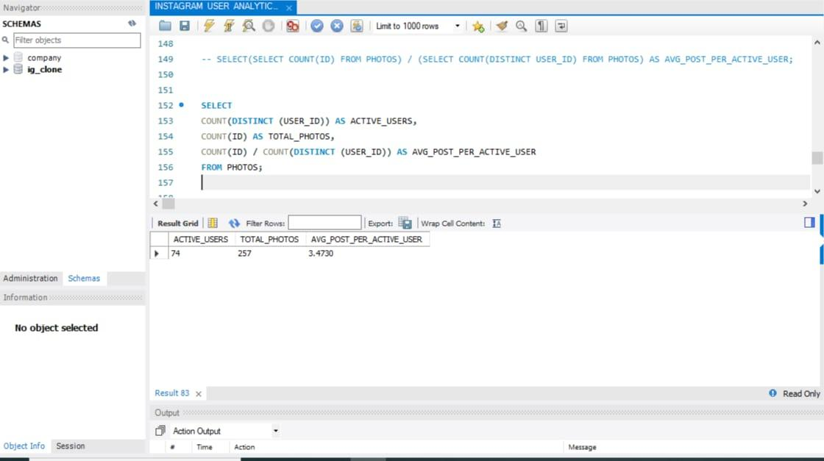
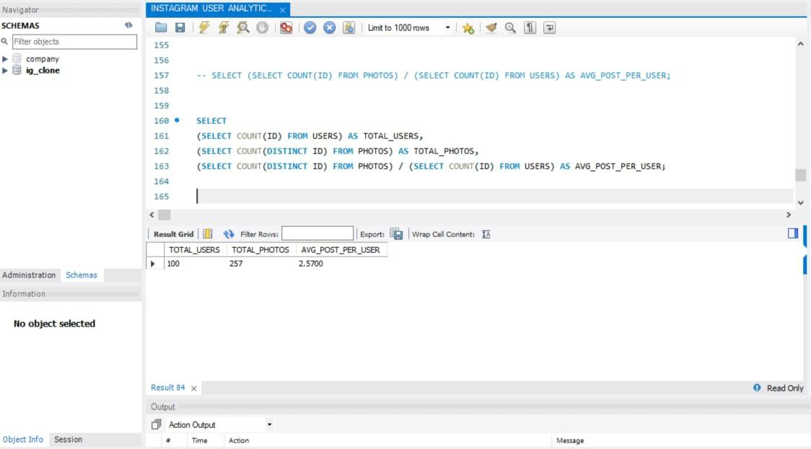
MYSQL QUERY & RESULT
INSIGHT
INVESTOR METRICS(USER ENGAGEMENT)
Here, we’ll find the ‘average post a user posts to understand the engagement’.
Result, through result we’ll come to know ‘are users still active?’ or ‘are users liking this app?’. If not then how to adopt such methods to engage them.

Slide 9
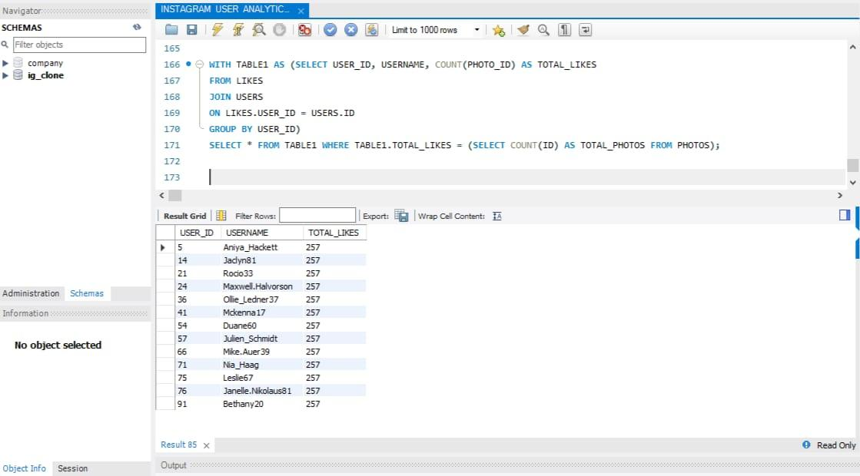
MYSQL QUERY & RESULT
INSIGHT
INVESTOR METRICS (BOTS AND FAKE ACCOUNTS)
Here, we’ll find ‘those uses who have liked every single photo on Instagram’ because for a normal user it is not possible to like each and every photo.
Result, It is done to find
Out the fake accounts on Instagram.

Slide 10
RESULT AND LEARNINGS
• How Big data and analytics helps in managing these platforms and interact with users by giving them timely reminders about their posts stories etc.
• How to manage data using Analytics.
• How to target your audience and keep them with the platform for longer time.
• How to advertise different products and services using most used hashtags by the users and engage them.

